Slide 1



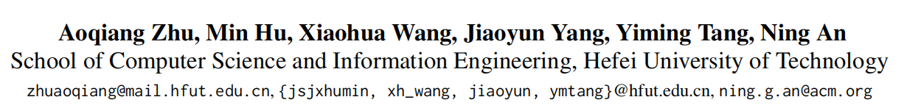





Chongqing University of Technology
ATAI
Advanced Technique of Artificial Intelligence
Chongqing University of Technology
Multimodal Invariant Sentiment Representation Learning
Code：https://github.com/aoqzhu/MISR
—— ACL 2025
Reported by ZhiWei Xu

Slide 2
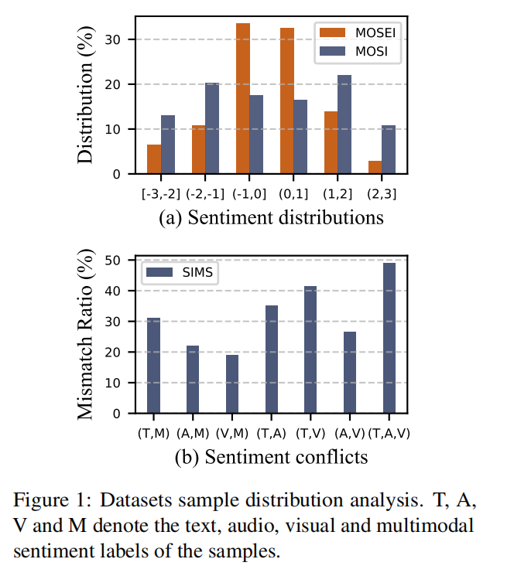
Motivation
(1) As shown in Fig. 1(a), it is evident that in the MOSEI dataset, sentiment valuespredominantly fall within the range of [-1,1], accounting for 65.97% of the samples.The imbalance in the sentiment distribution of the data causes the model to bias toward predictions of high-frequency sentiments, while insufficiently
learning low-frequency sentiments.
(2) Due to the intrinsic uncertainty of the data , there are conflicting sentiment across modalities.This conflict leads to contradictions between modalities, interfering with the fusion process.

Slide 3
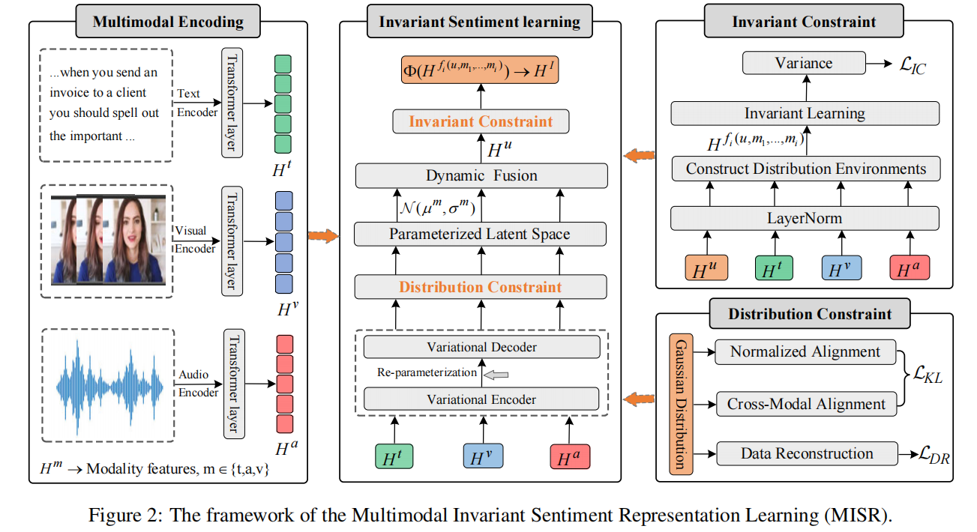
Method

Slide 4

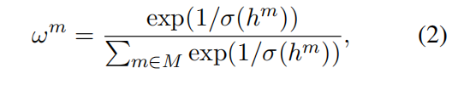




Method

Slide 5






Method

Slide 6
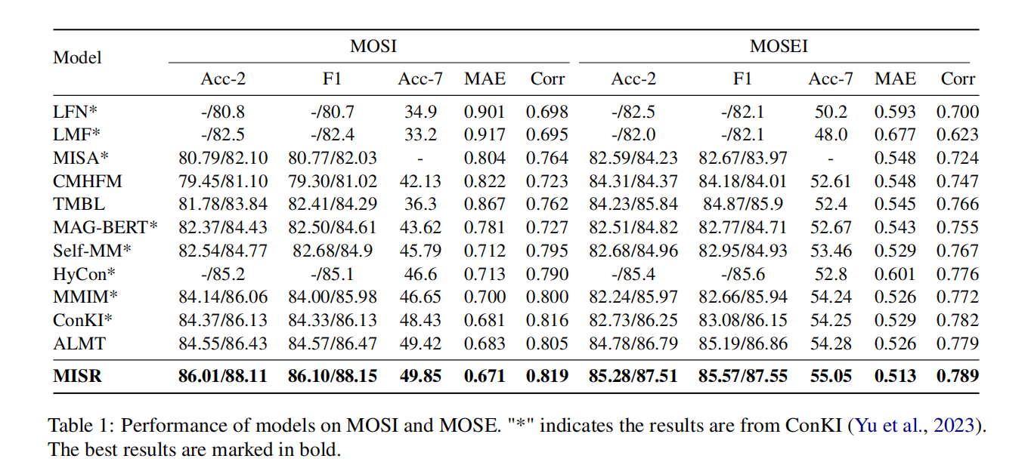
Experiments

Slide 7
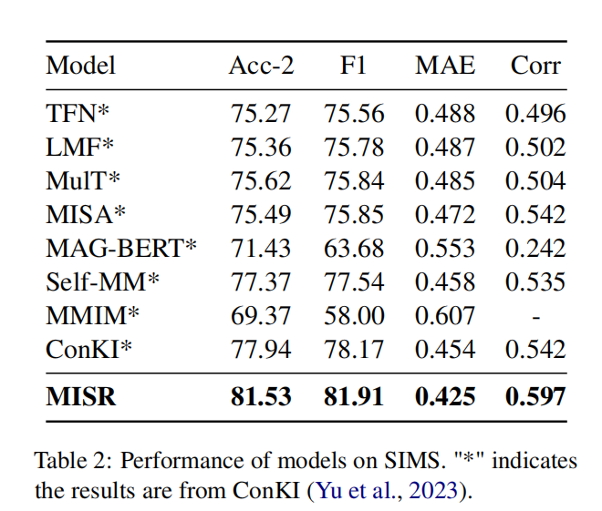
Experiments

Slide 8
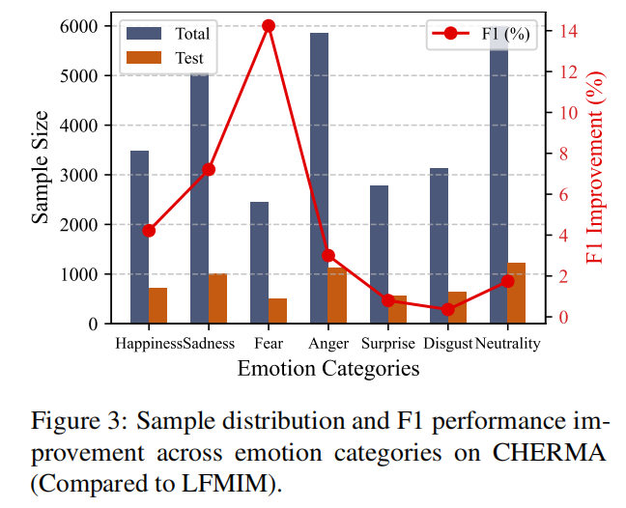
Experiments

Slide 9
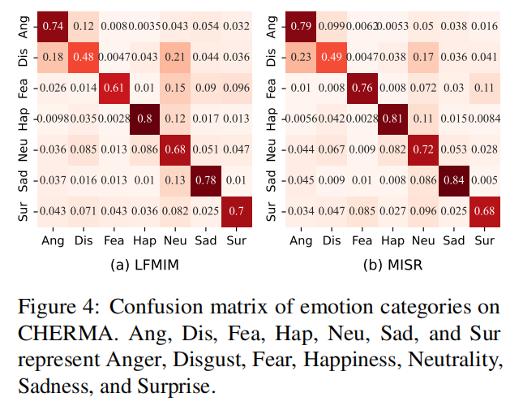
Experiments

Slide 10
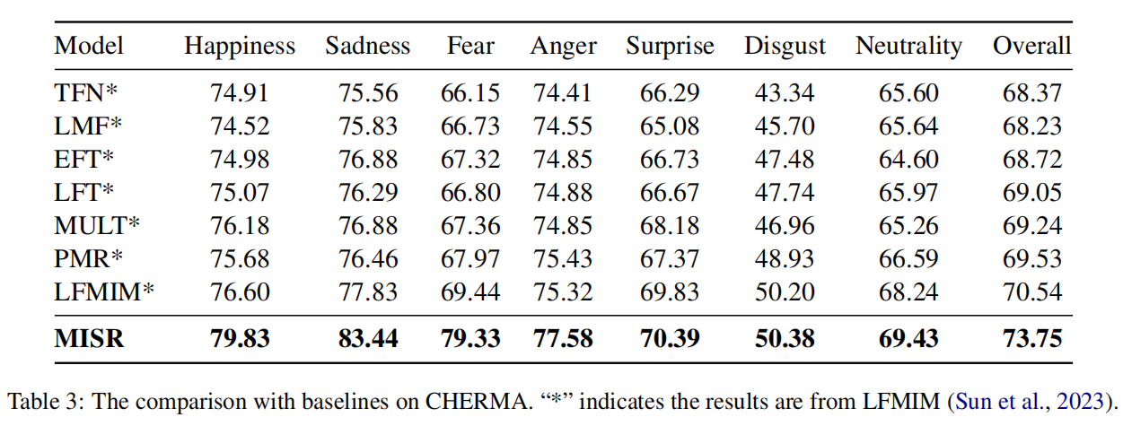
Experiments

Slide 11
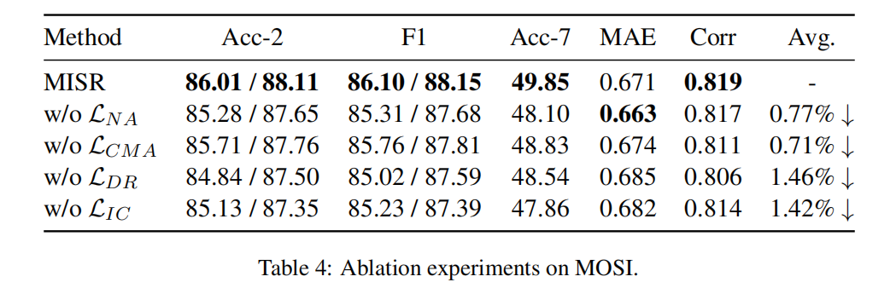
Experiments

Slide 12
Thanks!

